Slide 1
Activity 1: Investigating Plants in the Light

Slide 2
What happens when plants gain mass?
Where are atoms moving from?
Where are atoms moving to?
Chemical change
What molecules are carbon atoms in before the change? What other molecules are involved?
What molecules are carbon atoms in after the change? What other molecules are produced?
What forms of energy are in the reactants?
What forms of energy are in the products?
Remember: Atoms last forever (so you can rearrange atoms into new molecules, but can’t add or subtract atoms) Energy lasts forever (so you can change forms of energy, but energy units can’t appear or go away)
Notes:
Teaser process tool for all investigations except soda water

Slide 3
Three Questions Poster
Question | Rules to Follow | Evidence to Look For
The Movement Question: Where are atoms moving? Where are atoms moving from? Where are atoms going to? | Atoms last forever in combustion and living systems All materials (solids, liquids, and gases) are made of atoms | When materials change mass, atoms are moving When materials move, atoms are moving
The Carbon Question: What is happening to carbon atoms? What molecules are carbon atoms in before the process? How are the atoms rearranged into new molecules? | Carbon atoms are bound to other atoms in molecules Atoms can be rearranged to make new molecules | The air has carbon atoms in CO₂ Organic materials are made of molecules with carbon atoms Foods Fuels Living and dead plants and animals
The Energy Question: What is happening to chemical energy? What forms of energy are involved? How is energy changing from one form to another? | Energy lasts forever in combustion and living systems C-C and C-H bonds have more stored chemical energy than C-O and H-O bonds | We can observe indicators of different forms of energy Organic materials with chemical energy Light Heat energy Motion

Slide 4
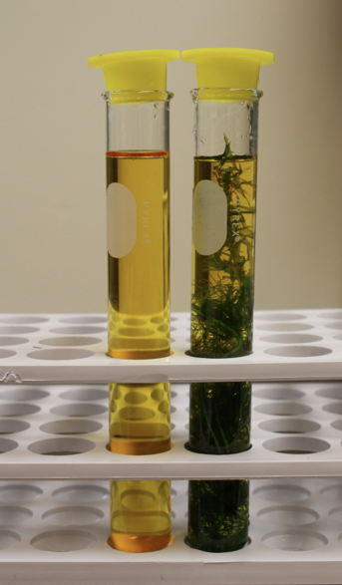
Plants in the Light Investigation
Now that we have set up the investigation, what do we think will happen? Why?
?
Notes:
If students need to be reminded of the BTB colors, use the next slide.

Slide 5
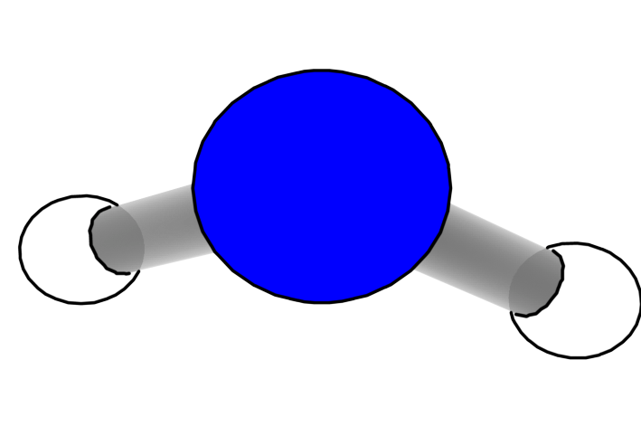
The Molecules in Water
Pure water contains only water molecules, but the water in streams and in our soil is not pure.
What other molecules are in water?

Slide 6
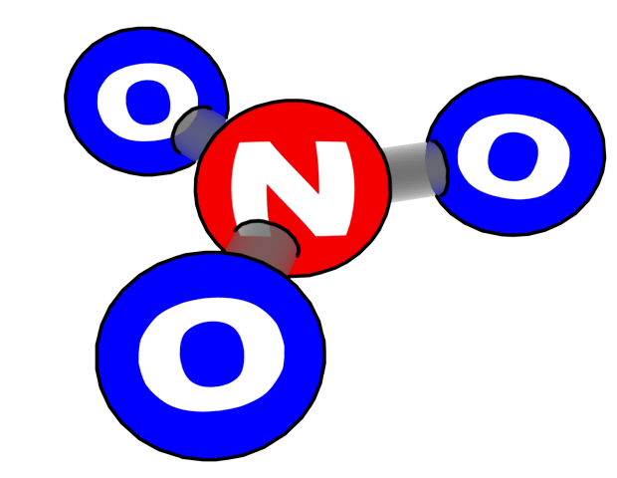
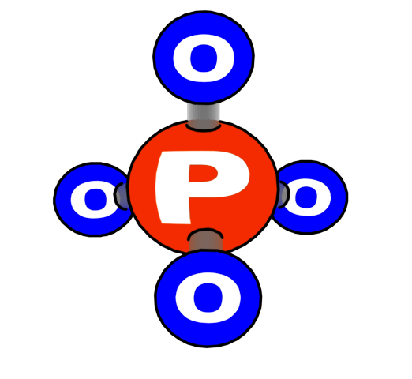
Dissolved Minerals in Water
Water also contains dissolved minerals that are nutrients for plants. These minerals have different kinds of atoms, including:
Nitrogen
Phosphorous
Calcium
Sodium

Slide 7
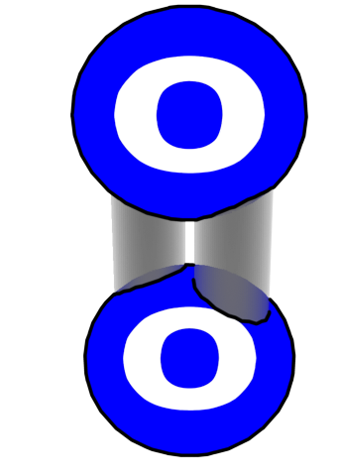
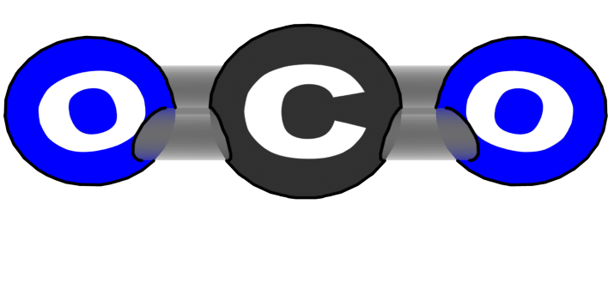
Dissolved Gases in Water
Water also contains dissolved gases from the air, including:
Nitrogen (N₂)
Oxygen (O₂)
Carbon dioxide (CO₂)

Slide 8
Question about BTB
What does BTB tell us about the materials dissolved in the water?

Slide 9
Possible BTB Colors

Slide 10
Record your observations of color change here.
 | Test Tube With Plant |  | Control
 | Start BTB Color | End BTB Color | Start BTB Color | End BTB Color
1 | Yellow |  | Yellow
2 | Yellow |  | Yellow
3 | Yellow |  | Yellow
4 | Yellow |  | Yellow
5 | Yellow |  | Yellow
6 | Yellow |  | Yellow
7 | Yellow |  | Yellow

Slide 11
Explaining your Results
What are your observations of color change? (how did the color change?)
What are our conclusions based on these observations? (what happened??)
Notes:
Answer these questions as a class. Alternatively, you can write these results on the class poster in PlantsPosters.pptx or in PlantsClassResults.xlsx.

Slide 12
Why did this happen?
Notes:
Ideally, students will be able to construct an account of gas exchange during photosynthesis that includes carbon (transforming from CO2 to C6H12O6) and energy (from light energy from the sun to chemical energy in the bonds). Students will have unanswered questions about this. The handout reading will help clarify some of their answers.

Slide 13
What new ideas do you have about what happens when plants gain mass?
Where are atoms moving from?
Where are atoms moving to?
Chemical change
What molecules are carbon atoms in before the change? What other molecules are involved?
What molecules are carbon atoms in after the change? What other molecules are produced?
What forms of energy are in the reactants?
What forms of energy are in the products?
Remember: Atoms last forever (so you can rearrange atoms into new molecules, but can’t add or subtract atoms) Energy lasts forever (so you can change forms of energy, but energy units can’t appear or go away)
Notes:
Teaser process tool for all investigations except soda water

Slide 14
Activity 2: Modeling Photosynthesis
Answering the Three Questions for how plants grow.

Slide 15
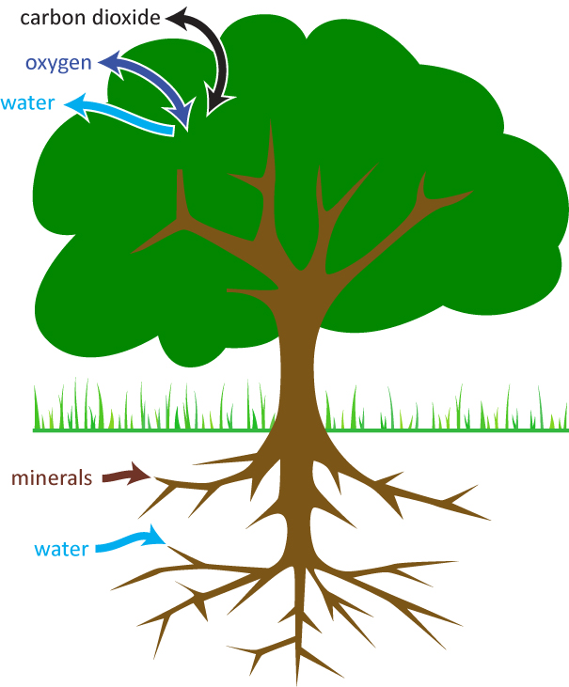
The Movement Question
Where are atoms moving from?
Where are atoms moving to?
Notes:
Have students answer share their ideas to these basic questions by looking at the picture. Atoms are moving from the air into the leaves, from water into the roots, and from the leaves into the air.

Slide 16
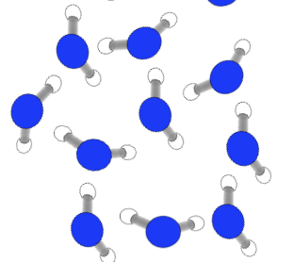
Which atoms and molecules are moving?
Water | Minerals
Carbon dioxide | Oxygen
Notes:
CO2 and water go in, glucose is created, and O2 comes out.

Slide 17
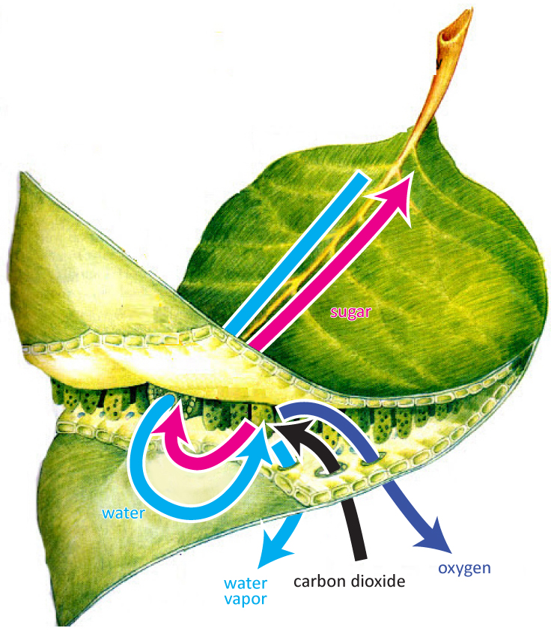
Leaf: Movement of atoms during photosynthesis
Question: Where did the sugar come from?
Notes:
Note that CO2 is entering from the leaves and water is entering from the other part of the plant. Then, water and oxygen are leaving the plant and sugar is getting sent to other parts of the plant.

Slide 18
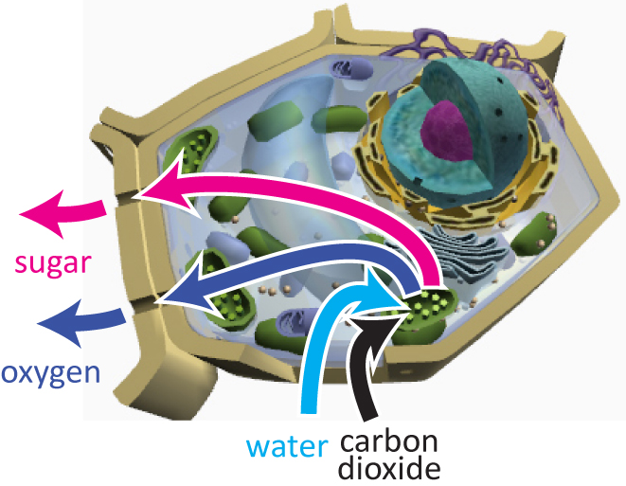
Leaf Cell: Microscopic Scale
Movement of atoms during photosynthesis
Question: How can sugar come out of leaf cells when carbon dioxide and water—but no organic materials—are going in?
Notes:
This slide demonstrates the transformation of photosynthesis at cellular level. Water and carbon dioxide move into the plant, and sugar and oxygen come out.

Slide 19
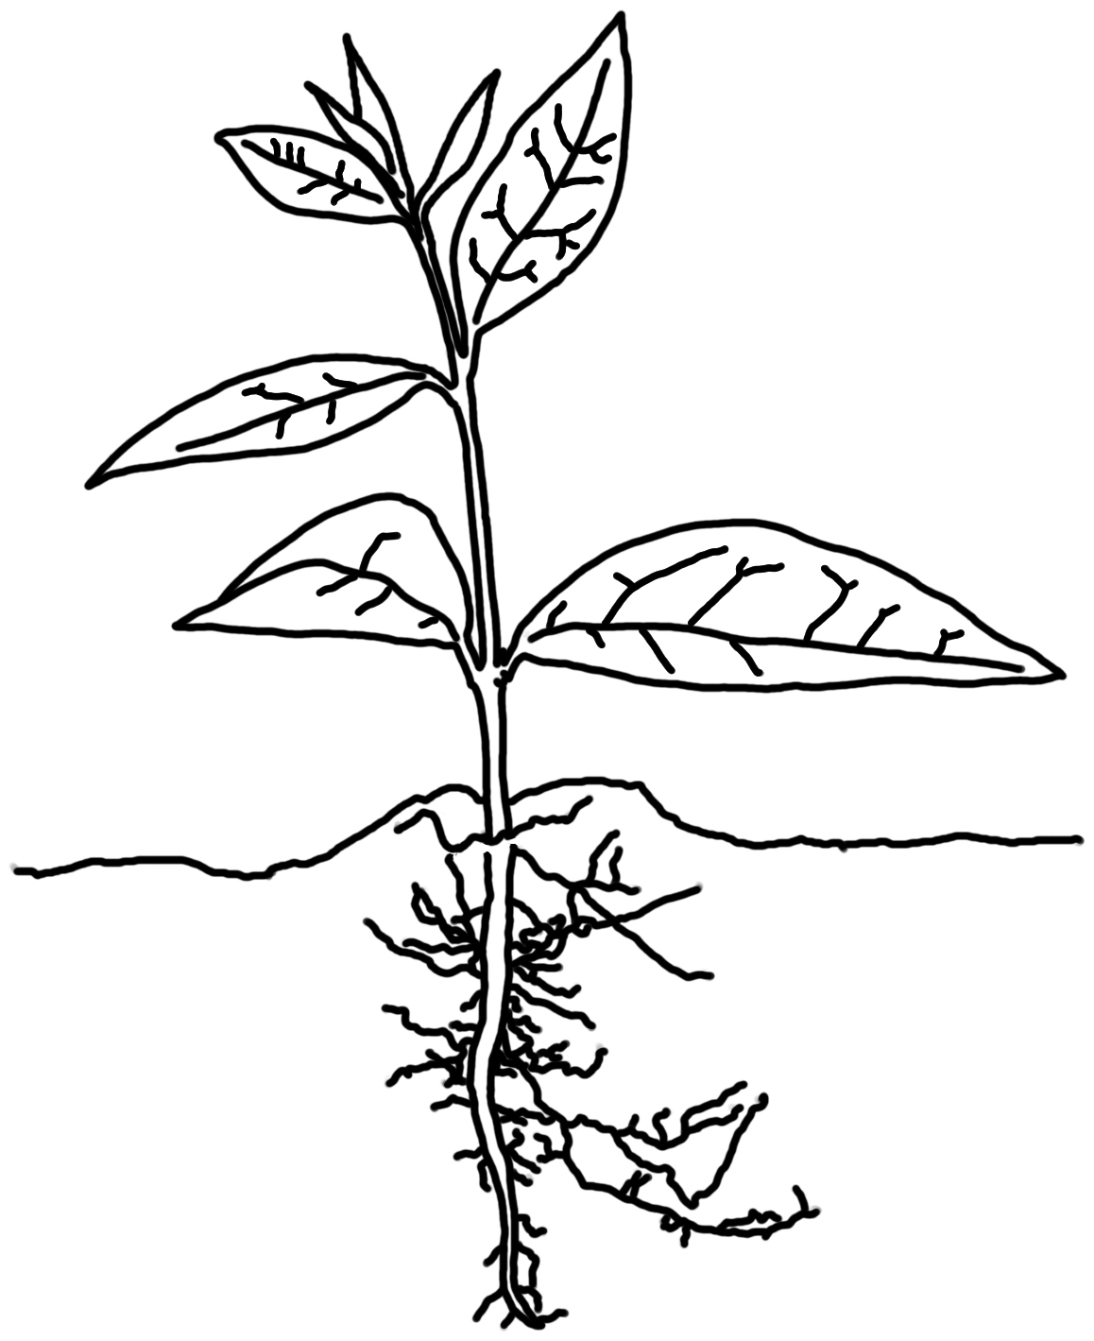
What is Photosynthesis?
Photosynthesis is the secret of plant growth.
Plants do photosynthesis so they can grow (gain biomass).
Notes:
Use the following slides to talk about photosynthesis with your students and introduce the photosynthesis reading while you are waiting for the results.

Slide 20
The Carbon Question: What is happening to carbon atoms?
What molecules are carbon atoms in before photosynthesis?
How are the atoms rearranged into new molecules during photosynthesis?
The Energy Question: What is happening to energy?
What forms of energy are involved in photosynthesis?
How is energy changing from one form to another during photosynthesis?
Notes:
Carbon: carbon is changed from CO2 into C6H12O6.
Energy: energy is changed from light energy to chemical energy in the bonds of the glucose molecule.

Slide 21
Photosynthesis happens when light energy from the sun, carbon dioxide, and water are used to make sugar and oxygen. (the sugar is then used to build the plant’s mass; the O₂ is released as waste)
Notes:
The sugar is the product that is used to gain mass. Sugars are combined with other molecules to make large organic compounds (fats, carbs, and proteins) that build the body of the plant.

Slide 22
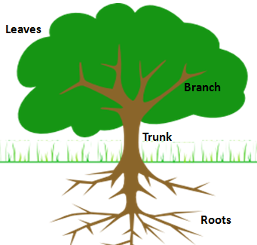
Materials in Photosynthesis: Reactants and Products
water
sugar
(From roots to leaves)
(From leaves to all parts of tree)
carbon dioxide
oxygen
(From leaves to air)
(From air to leaves)
Notes:
Reactants and products. This helps answer the carbon question. This takes place inside the leaf. Sugar and glucose are used interchangably.

Slide 23
Using your poster and modeling kits, make a model of how matter and energy are transformed during photosynthesis.

Slide 24
Rules of Molecular Bonding Reminder:
Atoms in stable molecules always have a certain number of bonds to other atoms:
Carbon: 4 bonds
Oxygen: 2 bonds
Hydrogen: 1 bond
This means that if you have a carbon atom, for example, all 4 of its “prongs” should be attached to other atoms. There should not be empty prongs.
Oxygen atoms do NOT bond to other oxygen atoms if they can bond to carbon or hydrogen instead.

Slide 25
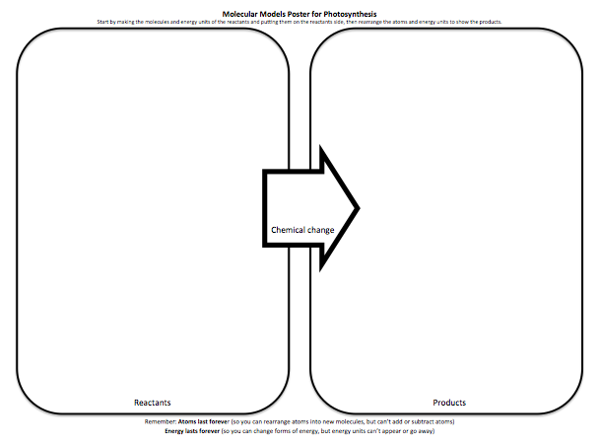
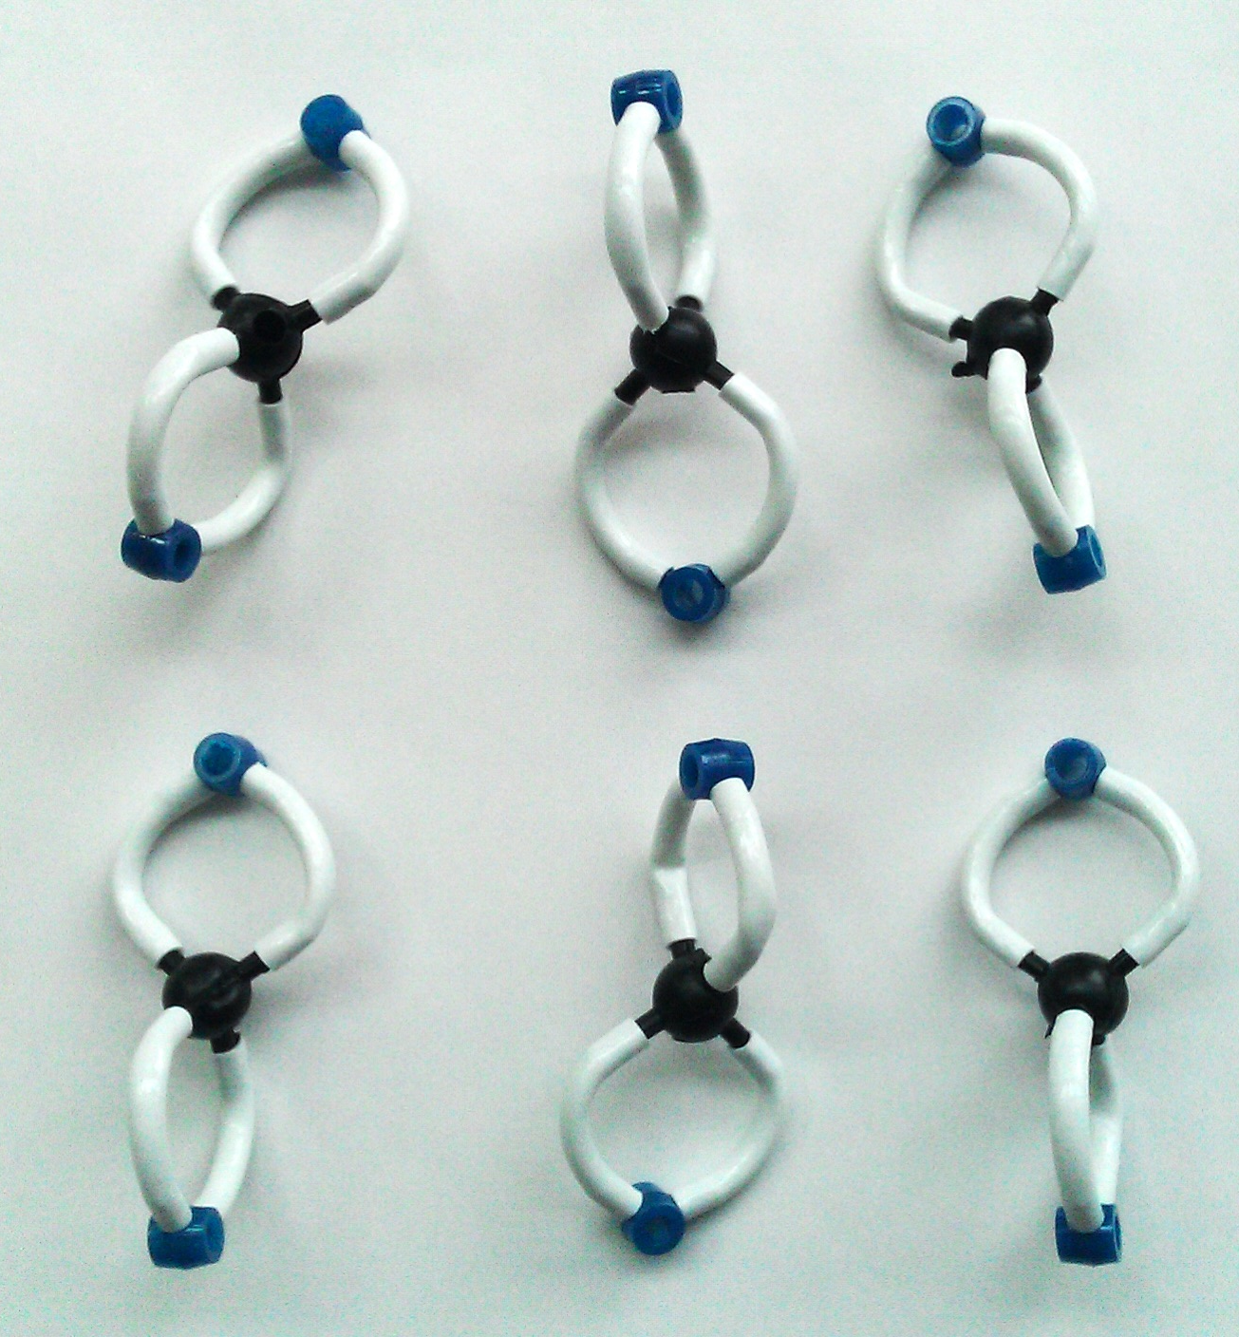
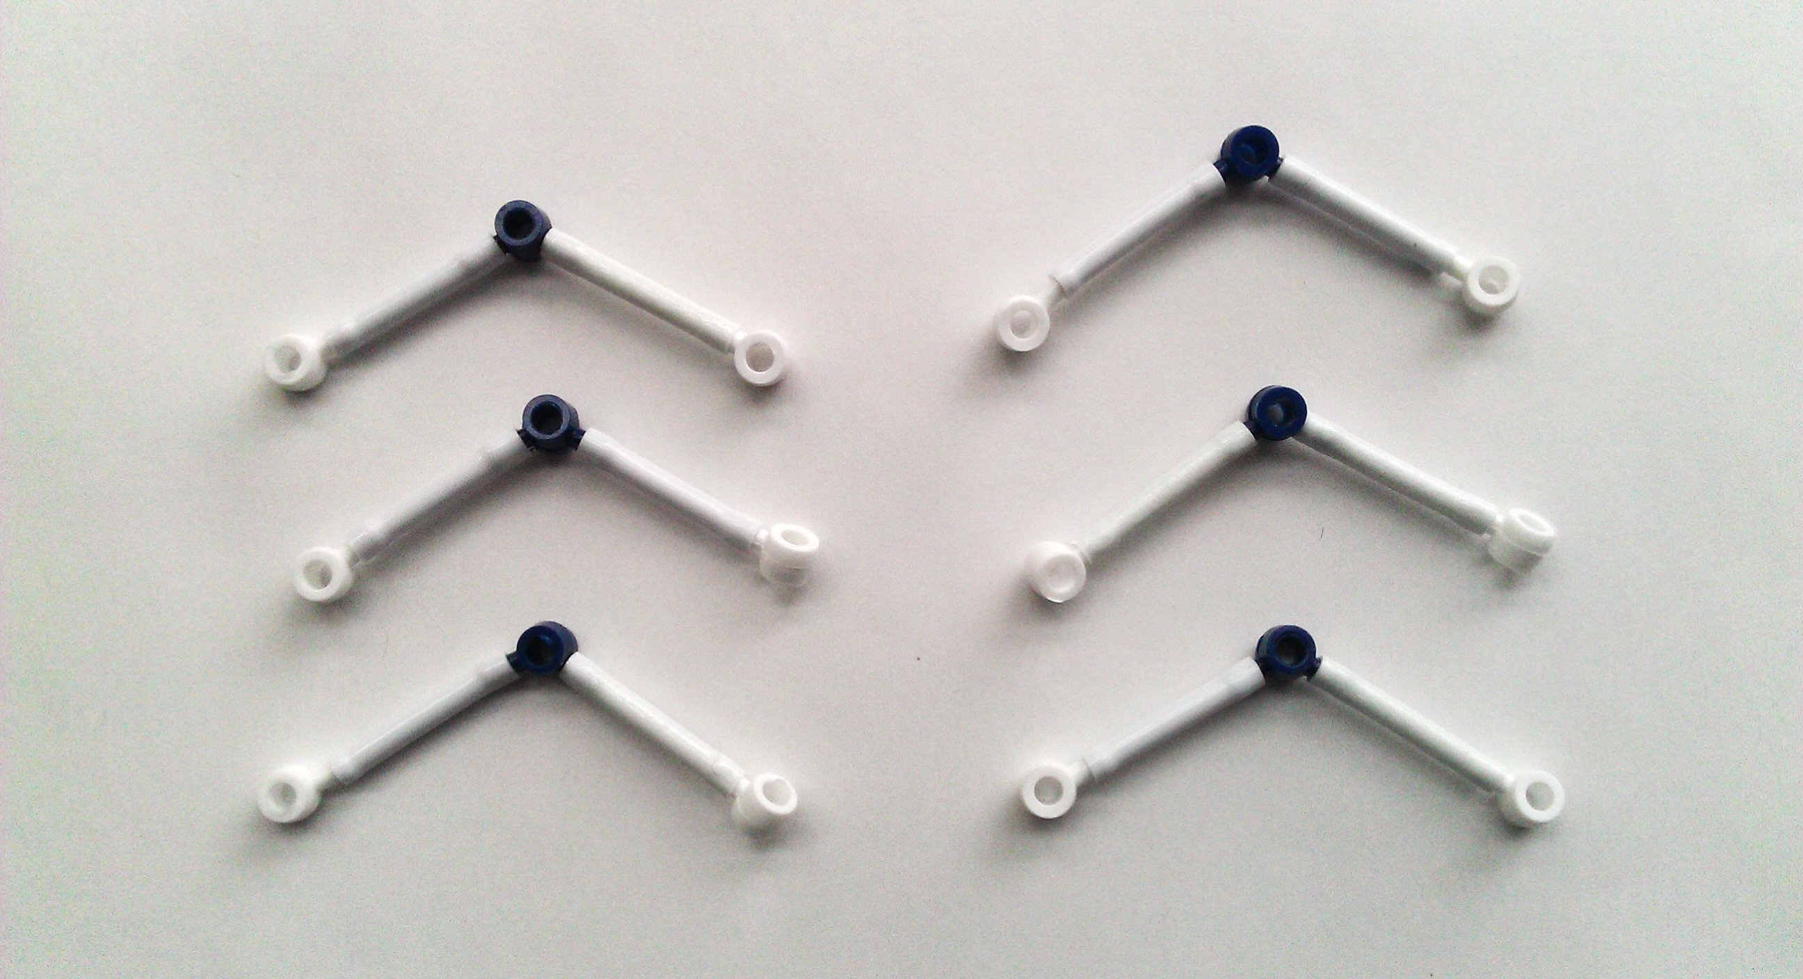
Light Energy
Carbon dioxide
Water

Slide 26
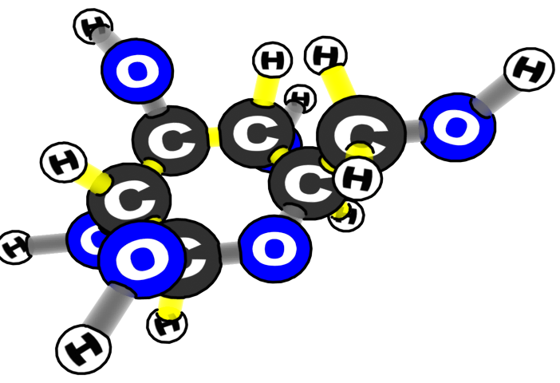
When you’re done, what will it look like? Arrange your atoms so that the water and carbon dioxide are transformed to glucose and oxygen.

Slide 27
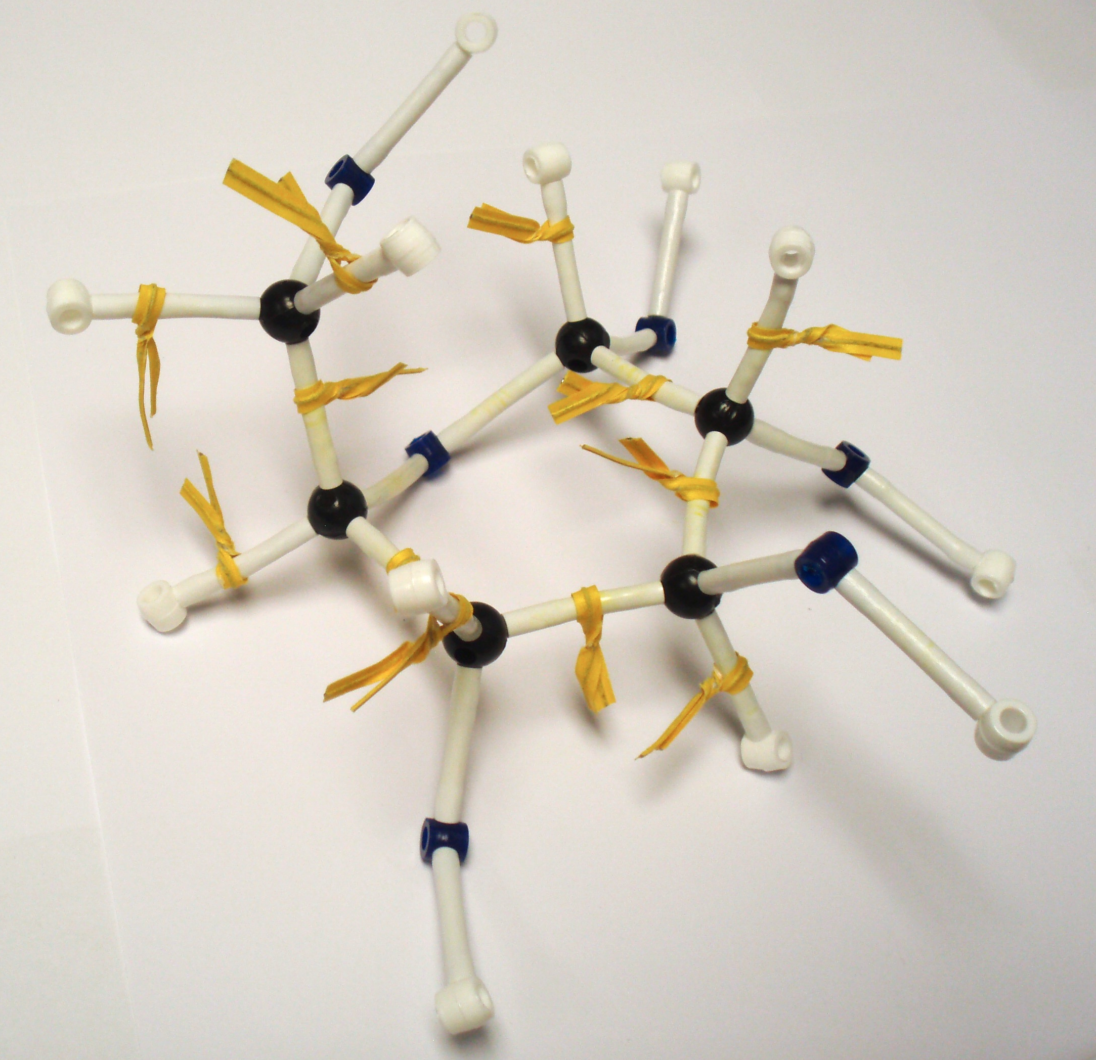
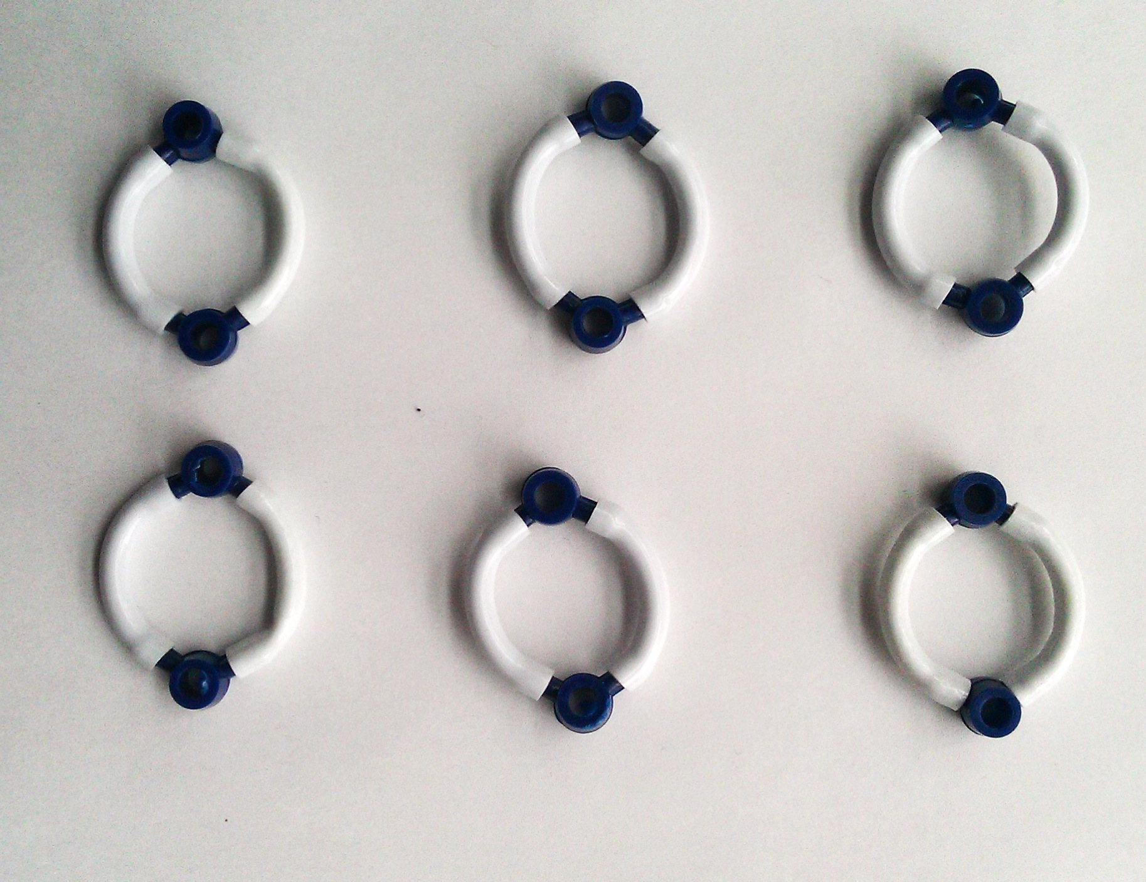
Molecular Models Poster for Photosynthesis Start by making the molecules and energy units of the reactants and putting them on the reactants side, then rearrange the atoms and energy units to show the products.
Glucose with
chemical energy
Chemical change
Oxygen
Reactants
Products
Remember: Atoms last forever (so you can rearrange atoms into new molecules, but can’t add or subtract atoms)
Energy lasts forever (so you can change forms of energy, but energy units can’t appear or go away)
Notes:
Explain that in this poster, reactants (starting materials) will go in the square on the left, and “products” (ending materials) will go in the square on the right.

Slide 28
Molecular Models Poster for Photosynthesis Start by making the molecules and energy units of the reactants and putting them on the reactants side, then rearrange the atoms and energy units to show the products.
Light Energy
Glucose with
chemical energy
Carbon dioxide
Chemical change
Oxygen
Water
Reactants
Products
Remember: Atoms last forever (so you can rearrange atoms into new molecules, but can’t add or subtract atoms)
Energy lasts forever (so you can change forms of energy, but energy units can’t appear or go away)

Slide 29
Writing a Chemical Equation
Writing in symbols: Chemists use an arrow to show how reactants change into products: [reactant molecule formulas] → [product molecule formulas]
Saying in words: Chemists read the arrow as “yield” or “yields”: [reactant molecule names] yield(s) [product molecule names]
Equations must be balanced: Atoms last forever, so reactant and product molecules must have the same number of each kind of atom.
Try it: can you write a balanced chemical equation to show the chemical change for photosynthesis?
Notes:
Refresh from Systems and Scale: how would we write and say the chemical equation for photosynthesis?

Slide 30
Chemical Equation for Photosynthesis
6H₂O + 6CO₂ → C₆H₁₂O₆ + 6O₂
(in words: water and carbon dioxide yield glucose and oxygen)

Slide 31
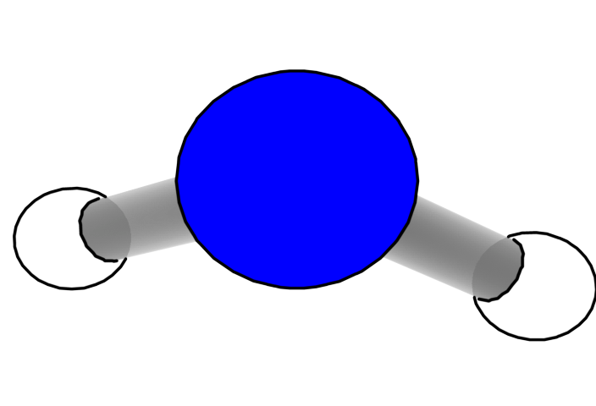
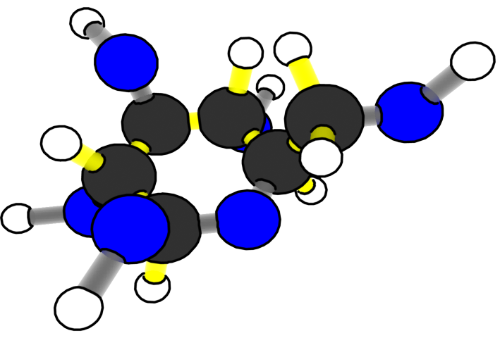
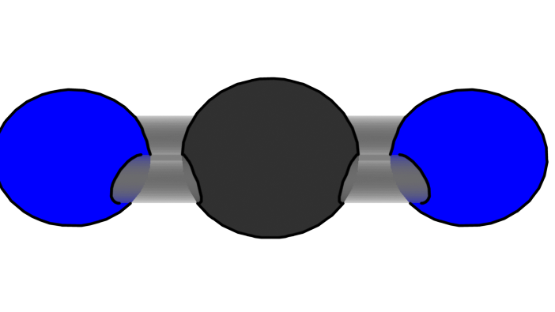
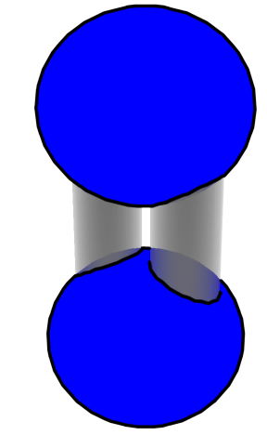
How would you say this equation?
H₂O
C₆H₁₂O₆
CO₂
O₂
Notes:
Look at movement of atoms during photosynthesis.. This slide also helps answer the carbon question.

Slide 32
How can we answer the Carbon Question and the Energy Questions now?
The Carbon Question: What is happening to carbon atoms?
What molecules are carbon atoms in before photosynthesis?
How are the atoms rearranged into new molecules during photosynthesis?
The Energy Question: What is happening to chemical energy?
What forms of energy are involved in photosynthesis?
How is energy changing from one form to another during photosynthesis?

Slide 33
The Carbon and Energy Questions
Carbon: carbon atoms move from CO₂ molecules in the air (inorganic) to C₆H₁₂O₆ molecules in the plant (organic).
Energy: energy is transformed from light energy into chemical energy in the high-energy (C-C and C-H) bonds of the glucose molecule.

Slide 34
What new ideas do you have about what happens when plants gain mass?
Where are atoms moving from?
Where are atoms moving to?
Chemical change
What molecules are carbon atoms in before the change? What other molecules are involved?
What molecules are carbon atoms in after the change? What other molecules are produced?
What forms of energy are in the reactants?
What forms of energy are in the products?
Remember: Atoms last forever (so you can rearrange atoms into new molecules, but can’t add or subtract atoms) Energy lasts forever (so you can change forms of energy, but energy units can’t appear or go away)
Notes:
Teaser process tool for all investigations except soda water

Slide 35
Activity 3: Zooming into Plants
Notes:
Introduce students to the purpose of the activity: to look at a plant from different scales: large scale, macroscopic, microscopic, and atomic-molecular.
Answering the carbon and energy questions: what form do carbon and energy take in a plant?

Slide 36
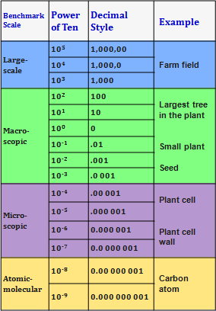
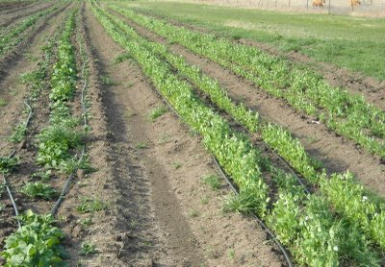
Large Scale: Farm field
Scale: 10³ meters = 1000 meters
Where is the energy stored in this picture?
Notes:
Slide 2: Large Scale
This slide uses the Powers of Ten poster to look at plants from a Farm perspective, or 10³ meters.
Answering the energy question: Where is the energy stored in this picture? Can we see it?
Energy is stored in the form of C-H and C-C bonds in the molecules of these cells. This is not visible at this scale.

Slide 37
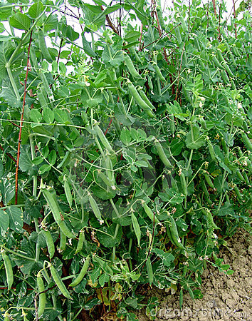
Macroscopic Scale: Pea Plant
Scale: 10⁰ meters = 1 meter
What form does carbon take in this picture?
Notes:
Slide 3 Macroscopic:
At 10⁰ meters (1 meter), we see one individual pea plant.
Answering the Carbon Question: What form is carbon in in this picture?
Carbon is in the form of fats, carbohydrates, and proteins in this picture. These are the organic molecules that seeds are made of, all of which are carbon-based

Slide 38
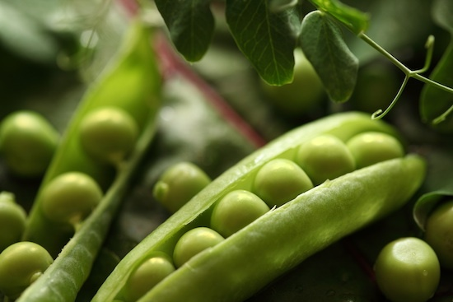
Macroscopic Scale: Seeds
Scale: 10⁻² or 10⁻³ meters
= 0.01 or 0.001 meter
What form of carbon is in these seeds?
Notes:
Slide 4: Macroscopic
This slide shows a seed, o a close up at the macroscopic level, 10⁻² meters. Leaves and seeds are visible.
Answering the Carbon Question: What form of carbon is in these seeds?
Carbon is in the form of fats, carbohydrates, and proteins in this picture. These are the organic molecules that seeds are made of, all of which are carbon-based

Slide 39
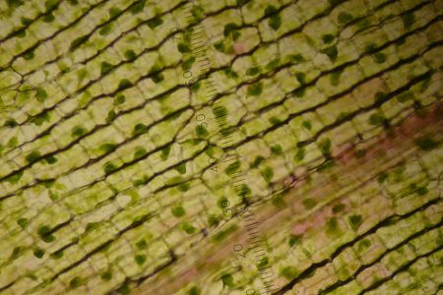
Microscopic Scale: Plant Cells
Scale: 10⁻⁶ meters
= 0.000001 meter
Where is the energy stored in this picture?
Notes:
In this slide you can see the plant’s cells and chloroplasts.
Answering the Energy Question: Where is the energy stored in this picture?
Energy is stored in the form of C-H and C-C bonds in the molecules of these cells. This is not visible at this scale.

Slide 40
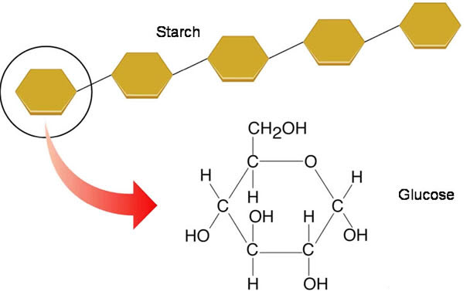
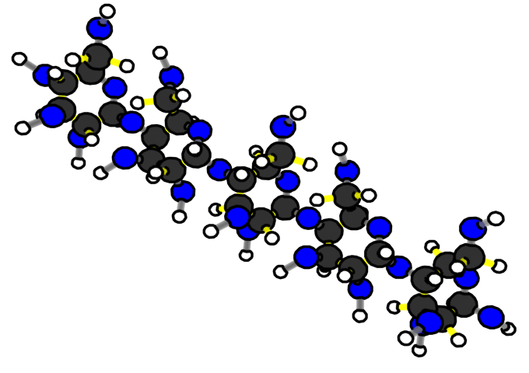
Atomic-molecular Scale: Glucose & Starch Molecules
Starch
Glucose
Scale: 10⁻⁹ meters
= 0.000000001 meter
Where is the energy stored in these molecules?
Notes:
Answering the energy question: Where is the energy stored in these molecules?
Glucose molecules are combined with other glucose molecules during biosynthesis to make up larger starch molecules. It is in the bonds of these molecules that the plant’s chemical potential energy is stored.

Slide 41
What atoms are found in a starch molecule?
C
Carbon atom
O
Oxygen atom
H
Hydrogen atom
Starch
What form of carbon is present in plants?
Notes:
Answering the carbon question: What form of carbon is present in plants?
All the materials that make up plants are organic because of the C-C and C-H bonds. These include not only glucose and starch, but also fats and proteins

Slide 42
What bonds are found in a starch molecule?
Carbon-Carbon
(C-C Bonds)
C
C
Carbon-Hydrogen
(C-H Bonds)
C
H
C
O
Carbon-Oxygen
(C-O Bonds)
Oxygen-Hydrogen
(O-H Bonds)
O
H
Starch
Where is the energy stored in this picture?
Notes:
Answering the Energy Question: Where is the energy stored in this picture?
Finally at the atomic/molecular level we see the bonds where the plant’s energy is stored.

Slide 43
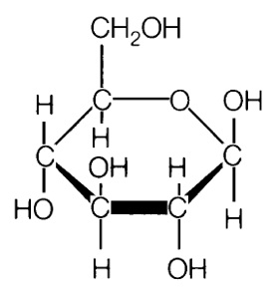
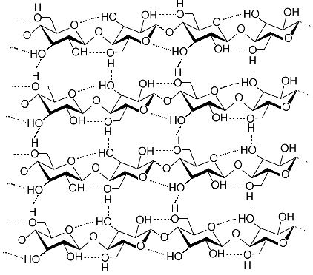
What are plants made of?CARBOHYDRATES
fiber (cellulose)
glucose
starch
What atoms are carbohydrates made of?

Slide 44
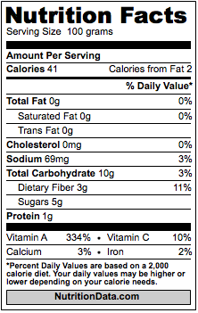
An Example of a Plant Root: Carrots
Total carbohydrate = starch + sugar + fiber (such as cellulose)
How much starch is in 100 grams of carrots?

Slide 45
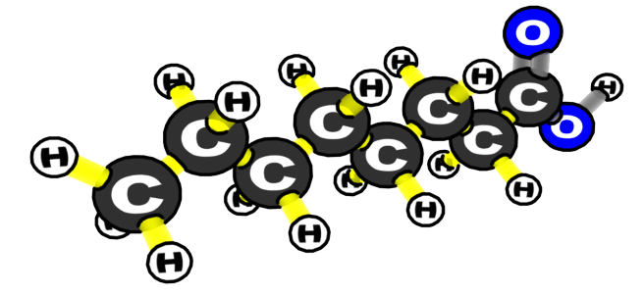
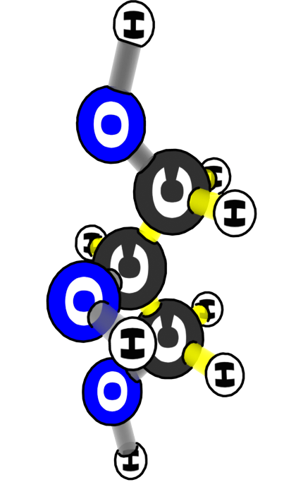
What are plants made of? FATS
1 glycerol
3 fatty acids
What atoms are fats made of?

Slide 46
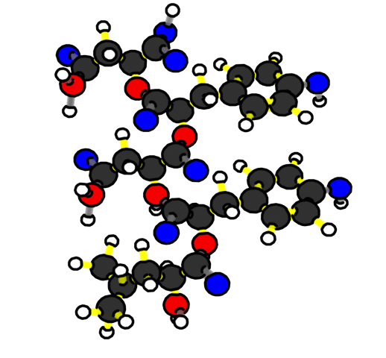
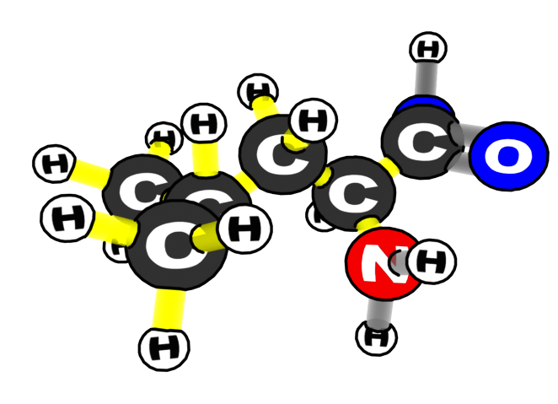
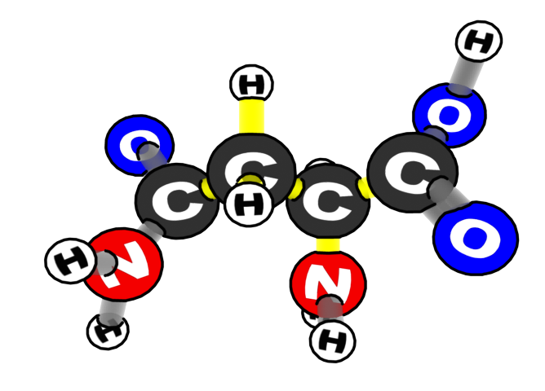
What are plants made of? PROTEIN
Two of the Amino Acids
What atoms are proteins made of?

Slide 47
Reading Nutrition Labels: Carrots
Vitamins, minerals, and cholesterol make up less than 1% of plants (less than 1 gram out of 100 grams).

Slide 48
Reading Nutrition Labels: Carrots
Besides organic materials or biomass (fats, proteins, and carbohydrates) plants are made up mostly of water.
About how much water is in 100 grams of carrots?

Slide 49
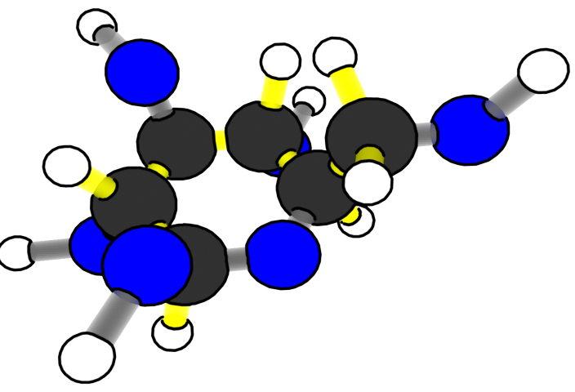
Comparing plant molecules
CARBBOHYDRATES:
FATS
GLUCOSE
STARCH
What atoms are organic molecules in plants made of?
PROTEINS
Notes:
All of these molecules have C-C and C-H bonds, which store chemical energy

Slide 50
Chemical Energy in a Plant Root: Carrots
Organic molecules in plants have chemical energy in their high-energy bonds (C-C and C-H).
Calories measure how much usable energy is stored in the organic molecules of a plant.

Slide 51
Plant Growth: The Carbon and Energy Questions
Carbon: Where do the atoms that make up carbohydrates, fats, and proteins come from?
Carbon
Oxygen
Hydrogen
Nitrogen
Energy: Where does the chemical energy in the high-energy (C-C and C-H) bonds of carbohydrates, fats, and proteins come from?

Slide 52
Plant Growth: The Carbon and Energy Questions
Carbon: Where do the atoms that make up carbohydrates, fats, and proteins come from?
Carbon: from CO₂ to glucose made in photosynthesis
Oxygen: from CO₂ to glucose made in photosynthesis
Hydrogen: from H₂O to glucose made in photosynthesis
Nitrogen: from soil minerals
Energy: Where does the chemical energy in the high-energy (C-C and C-H) bonds of carbohydrates, fats, and proteins come from?
From light to C-C and C-H bonds in glucose made in photosynthesis

